Slide 1


Bioinformatics Summer School
Introduction to IsoTools
Yalan Bi
Max Planck Institute for Molecular Genetics, Berlin, Germany
LongTREC - The Long-reads TRanscriptome European Consortium
Marie Skłodowska-Curie grant agreement No 101072892

Slide 2


IsoTools provides comprehensive functionalities for LRTS analysis
Transcriptome reconstruction
Quality control
Statistical analysis
Novel transcript classification
Visualisation
Data export
GitHub: https://github.com/HerwigLab/IsoTools2
Lienhard, Matthias et al. Bioinformatics (Oxford, England) vol. 39,6 (2023): btad364.
Bi, Yalan et al. Journal of molecular biology, 169049. 26 Feb. 2025.

Slide 3
Outline
Transcript identification and quantification
Gene model characteristics
Alternative splicing analysis
Transcriptome reconstruction

Slide 4
Input files and format
Transcriptome reconstruction
Reference-guided
Long-read genome alignments
Reference genome
Alignment file for each sample: *.bam
Gene model characteristics
Sequence file: *.fa (or *.fasta)
Index file: *.bam.bai
Alternative splicing analysis
Index file: *.fai
Tune aligner parameters for cleaner alignment
Reference annotation
Annotation file: *.gtf.gz (or *.gff3.gz)
Sample description file
Index file: *.gtf.gz.tbi
<sample_name> <file_name> <group>
Tools for indexing
Create the transcriptome object
Samtools and Tabix

Slide 5
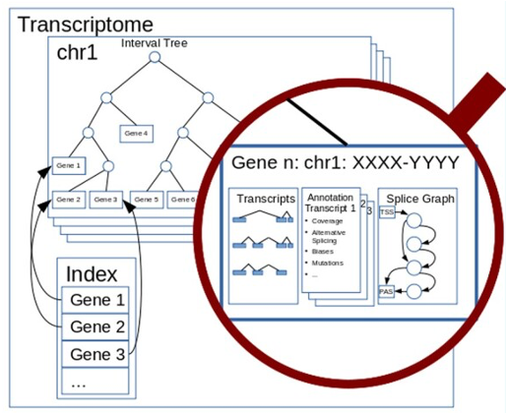
Data structure of the transcriptome object
Transcriptome reconstruction
Interval tree
A data structure that can represent genomic positions
Gene model characteristics
Alternative splicing analysis
An interval: starting and ending point
Efficient storage and query
Transcriptome object
Initiated from the reference annotation
Reconstructed based on long reads imported

Slide 6
Reconstruction from sample reads
Transcriptome reconstruction
Infer transcript model from reads from all samples.
Transcript identification
Transcript quantification
Increase the power to discover rare transcripts
Record how many reads from each sample for quantification
Gene model characteristics
Discard reads with a low alignment score or poor mapping quality.
Only consider the primary alignment.
Alternative splicing analysis

Slide 7
Reconstruction from sample reads
Transcriptome reconstruction
gene_A
Transcript identification
Transcript quantification
A
C
D
E
ref_tr_1
Gene model characteristics
Alternative splicing analysis
ref_tr_2
B
C
D
E

Slide 8
Reconstruction from sample reads
Transcriptome reconstruction
Reads → transcripts
gene_A
A
C
D
E
Transcript identification
Transcript quantification
Share same intron chain
ref_tr_1
Exact matching positions
ref_tr_2
B
C
D
E
Gene model characteristics
Alternative splicing analysis
tr_1
A
C
D
E
tr_2
B
C
D
E
tr_3
B
E

Slide 9
Reconstruction from sample reads
Transcriptome reconstruction
Reads → transcripts
gene_A
A
C
D
E
Transcript identification
Transcript quantification
ref_tr_1
Transcripts → genes
ref_tr_2
At least one splice junction overlapping
B
C
D
E
Gene model characteristics
Alternative splicing analysis
tr_1
A
C
D
E
gene
tr_2
B
C
D
E
tr_3
B
E

Slide 10
Reconstruction from sample reads
Transcriptome reconstruction
Reads → transcripts
gene_A
A
C
D
E
Transcript identification
Transcript quantification
ref_tr_1
Transcripts → genes
ref_tr_2
B
C
D
E
Gene model characteristics
Assign to reference genes
Alternative splicing analysis
tr_1
A
C
D
E
gene_A
tr_2
B
C
D
E
tr_3
B
E

Slide 11
Reconstruction from sample reads
Transcriptome reconstruction
Reads → transcripts
Transcript identification
Transcript quantification
Transcripts → genes
Gene model characteristics
Assign to reference genes
Alternative splicing analysis
Correct for splice junction ambiguities
Minor shift in the same direction on both sites

Slide 12

Reconstruction from sample reads
Transcription start site (TSS)
Polyadenylation site (PAS)
Transcriptome reconstruction
Reads → transcripts
Transcript identification
Transcript quantification
tr_1
Transcripts → genes
tr_2
tr_1
Gene model characteristics
Assign to reference genes
tr_3
Alternative splicing analysis
Correct for splice junction ambiguities
tr_2
tr_3
Determine end positions
Peak calling: find_peaks from Scipy

Slide 13
Transcript quantification
Transcriptome reconstruction
Read count
Transcript identification
Transcript quantification
The number of reads associated with a transcript to estimate its expression level
Gene model characteristics
Coverage table
Alternative splicing analysis
Row: samples
Column: transcripts of a gene

Slide 14
After transcriptome reconstruction
Transcriptome reconstruction
A large number of novel transcripts in the transcriptome
Some are true novel transcripts;
Gene model characteristics
Most are technical artifacts.
Alternative splicing analysis
Quality control
Select reliable transcripts for downstream analysis

Slide 15

Reflection​
There are some reads like below. They can be separated into two groups (group_1 and group_2) based on the intron chain.
Group_1 is identical to a reference transcript. The only difference between the two groups is a 3bp shift (between A and B) at the first splice site.
During transcript identification of IsoTools, …
group_1
this shift in group_2 will be corrected to A, and all reads will be grouped together.
A
C
D
E
this shift in group_2 will not be corrected. They will be kept as two groups.
group_2
this shift in group_2 will not be corrected. They are errors and will be discarded.
B
C
D
E

Slide 16
Outline
Transcript identification and quantification
Gene model characteristics
Alternative splicing analysis
Gene model characteristics

Slide 17
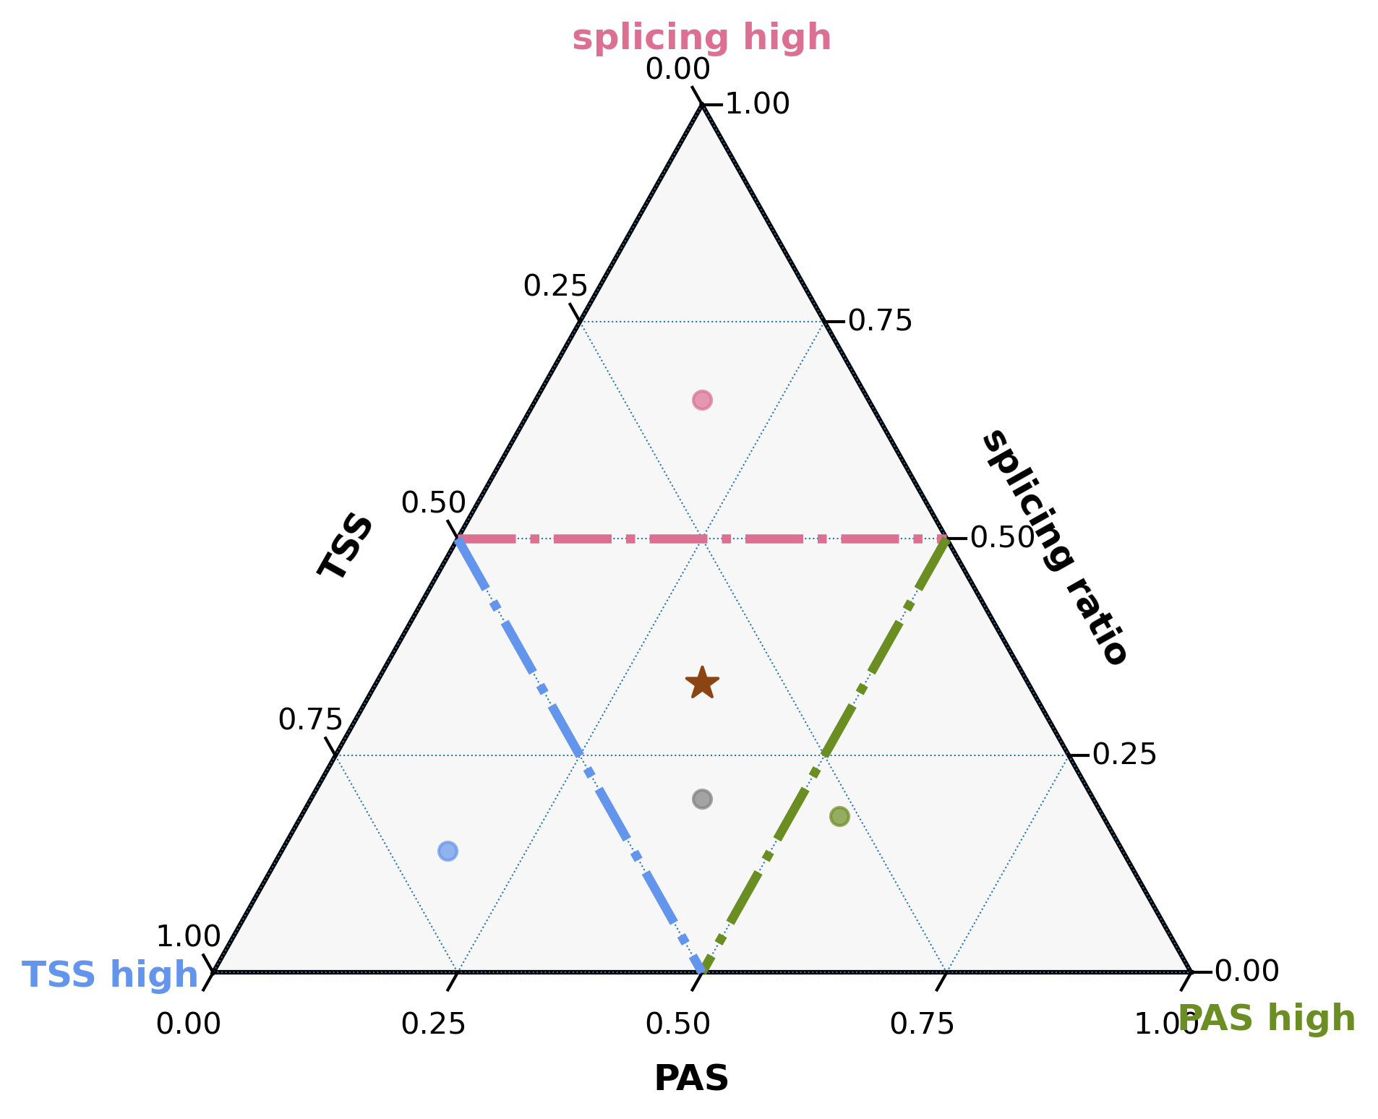
Transcript identification – structural variation
Transcriptome reconstruction
Simplex coordinates
Gene model characteristics
TSS
Mix
Structural variation
Expression variation
Exon chain
Alternative splicing analysis
Simple
PAS

Slide 18
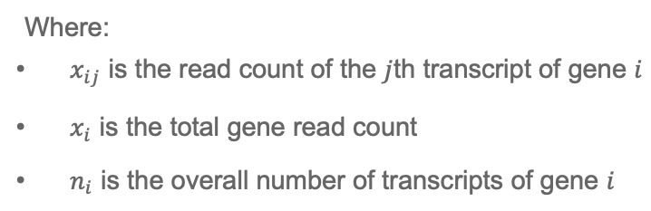
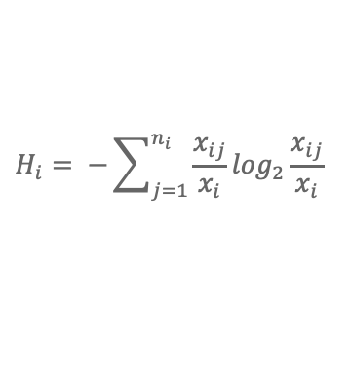

Transcript quantification – expression variation
Transcriptome reconstruction
$$H_{i}= −\sum_{j=1}^{n_{i}}{\frac{x_{ij}}{x_{i}}}\log_{2}{\frac{x_{ij}}{x_{i}}}$$
High entropy model
Gene model characteristics
Where:
$x_{ij}$ is the read count of the $j$th transcript of gene $i$
$x_{i}$ is the total gene read count
$n_{i}$ is the overall number of transcripts of gene $i$
Structural variation
Expression variation
Alternative splicing analysis
Low entropy model
$$R_{i}= \frac{H_{i}}{\log_{2}{n_{i}}}$$

Slide 19
Outline
Transcript identification and quantification
Gene model characteristics
Alternative splicing analysis
Alternative splicing analysis

Slide 20
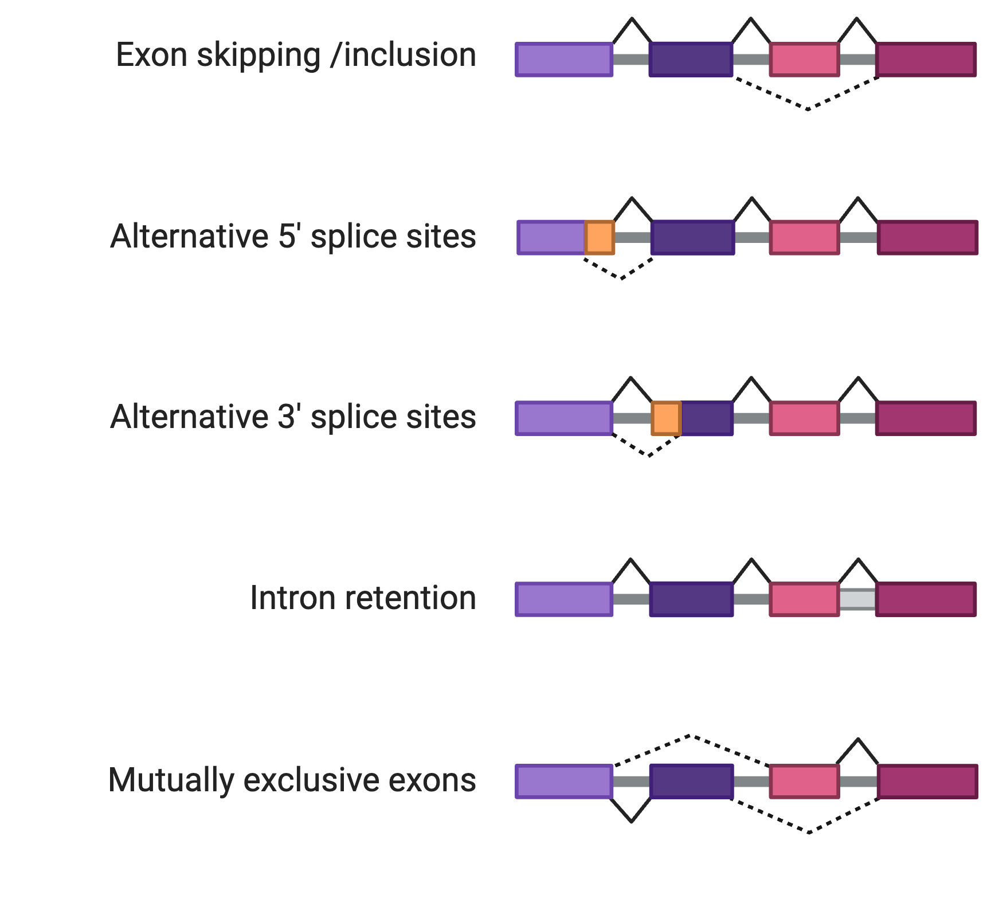
Common types of alternative splicing events (ASEs)
Transcriptome reconstruction
Gene model characteristics
Alternative splicing analysis
Created with BioRender.com

Slide 21
Representation of genes in segment graph
Transcriptome reconstruction
Gene model characteristics
Alternative splicing analysis

Slide 22
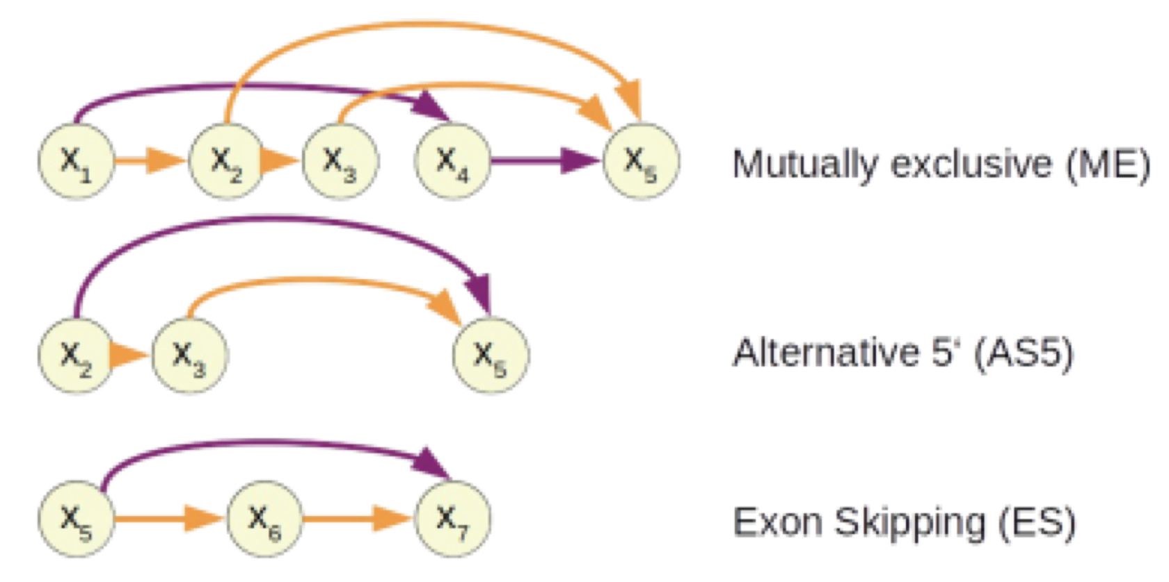
Identifying ASEs from segment graph
Transcriptome reconstruction
Gene model characteristics
Use bubbles to detect ASEs
Alternative splicing analysis
ASE is quantified with percent spliced in (PSI) values.
Number of reads support an ASE / total number of reads in the gene

Slide 23
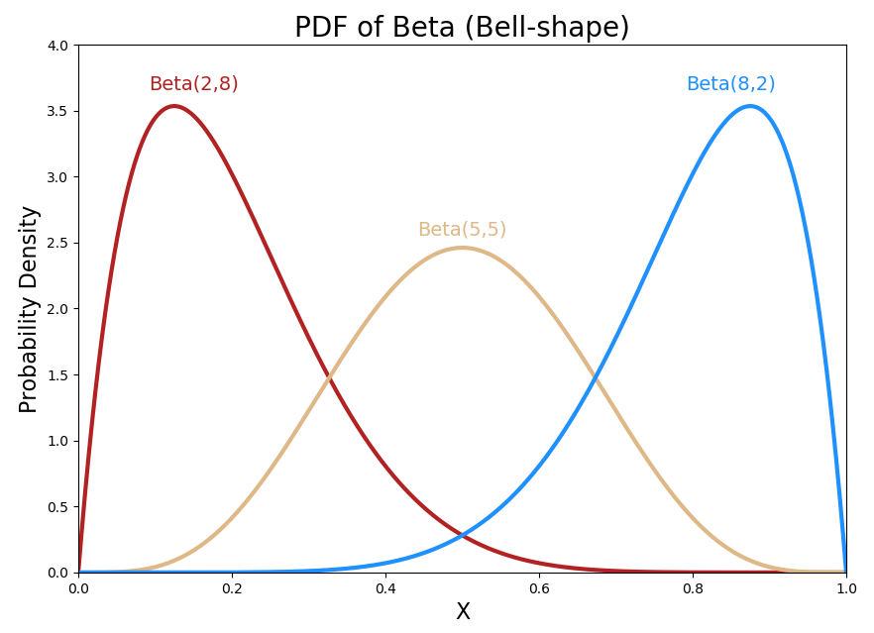

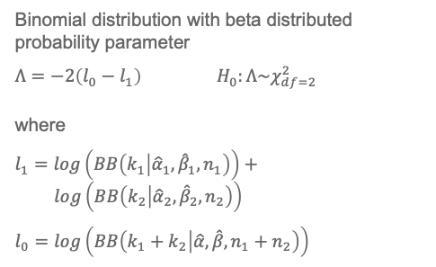
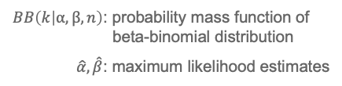
Differential splicing event analysis
Exon skipping
Transcriptome reconstruction
Gene model characteristics
Condition A
Condition B
Alternative splicing analysis
Statistical test
The number of reads support the ASE and the total number of reads in both conditions
Binomial distribution with beta distributed probability parameter
$Λ=−2\left(l_{0}−l_{1}\right)$ $H_{0}:Λ\sim χ_{df=2}^{2}$
where
$$l_{1}=log\left(BB\left(k_{1} | {\hat{α}}_{1},{\hat{β}}_{1},n_{1}\right)\right)+$$
$$log\left(BB\left(k_{2} | {\hat{α}}_{2},{\hat{β}}_{2},n_{2}\right)\right)$$
$$l_{0}=log\left(BB\left(k_{1}+k_{2} | \hat{α},\hat{β},n_{1}+n_{2}\right)\right)$$
A beta-binomial distributed model
Maximum likelihood to estimate optimal parameters
$BB\left(k | α,β,n\right)$: probability mass function of
beta-binomial distribution
$\hat{α},\hat{β}$: maximum likelihood estimates
Significant p-values
Differentially expressed ASEs

Slide 24
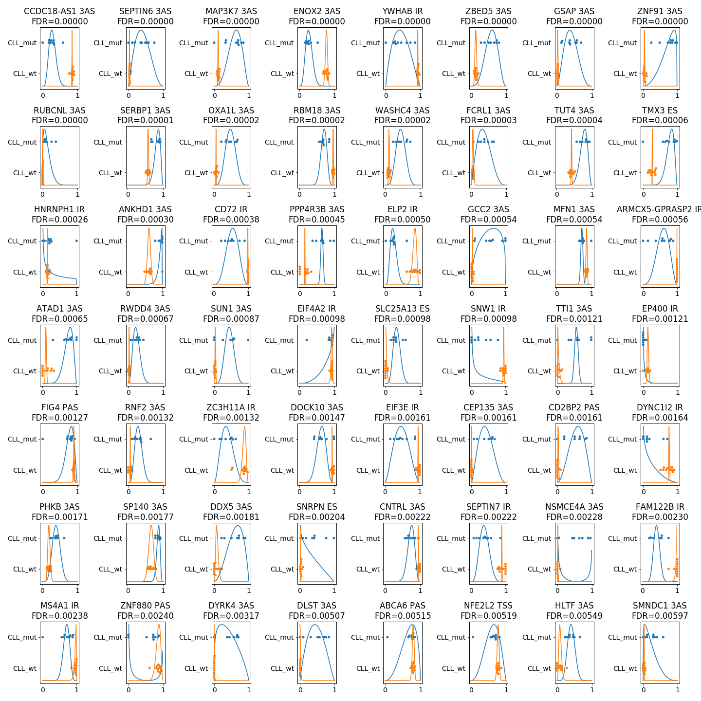
Differential splicing plot
Transcriptome reconstruction
Gene model characteristics
Alternative splicing analysis
Pacholewska, Alicja et al. Genome research vol. 34,11 1832-1848. 20 Nov. 2024, doi:10.1101/gr.279327.124

Slide 25
Summary
1
Overview of IsoTools
2
Transcript identification and quantification
3
Gene model characteristics
4
Alternative splicing and differential splicing analysis

Slide 26


Thank You!
For more information about the LongTREC Summer School:
https://longtrec.eu

Slide 27
TSS extension
TSS1
TSS2
Transcriptome reconstruction
Transcript identification
Transcript quantification
Reference
Gene model characteristics
TSS3
TSS4
Alternative splicing analysis
TSS2
Transcripts identified
TSS1

Slide 28
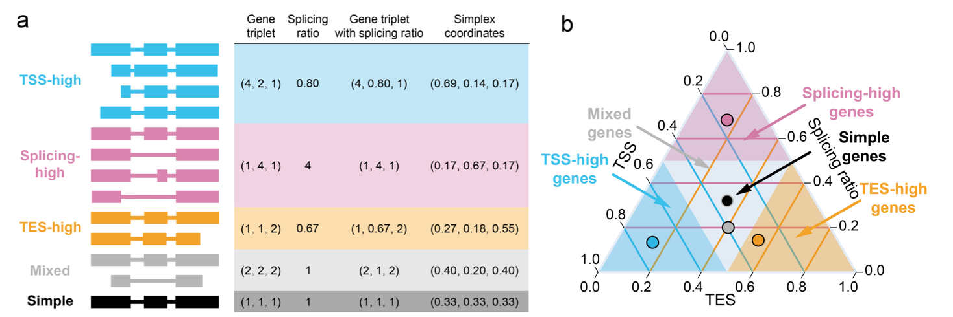

Simplex coordinates to measure structure diversity
Transcriptome reconstruction
$$\frac{2 × n_exon_chain}{n_tss+n_tes}$$
Gene model characteristics
Structural variation
Expression variation
Alternative splicing analysis
Reese, Fairlie et al. bioRxiv : the preprint server for biology 2023.05.15.540865. 16 May. 2023. Preprint.

